Slide 1


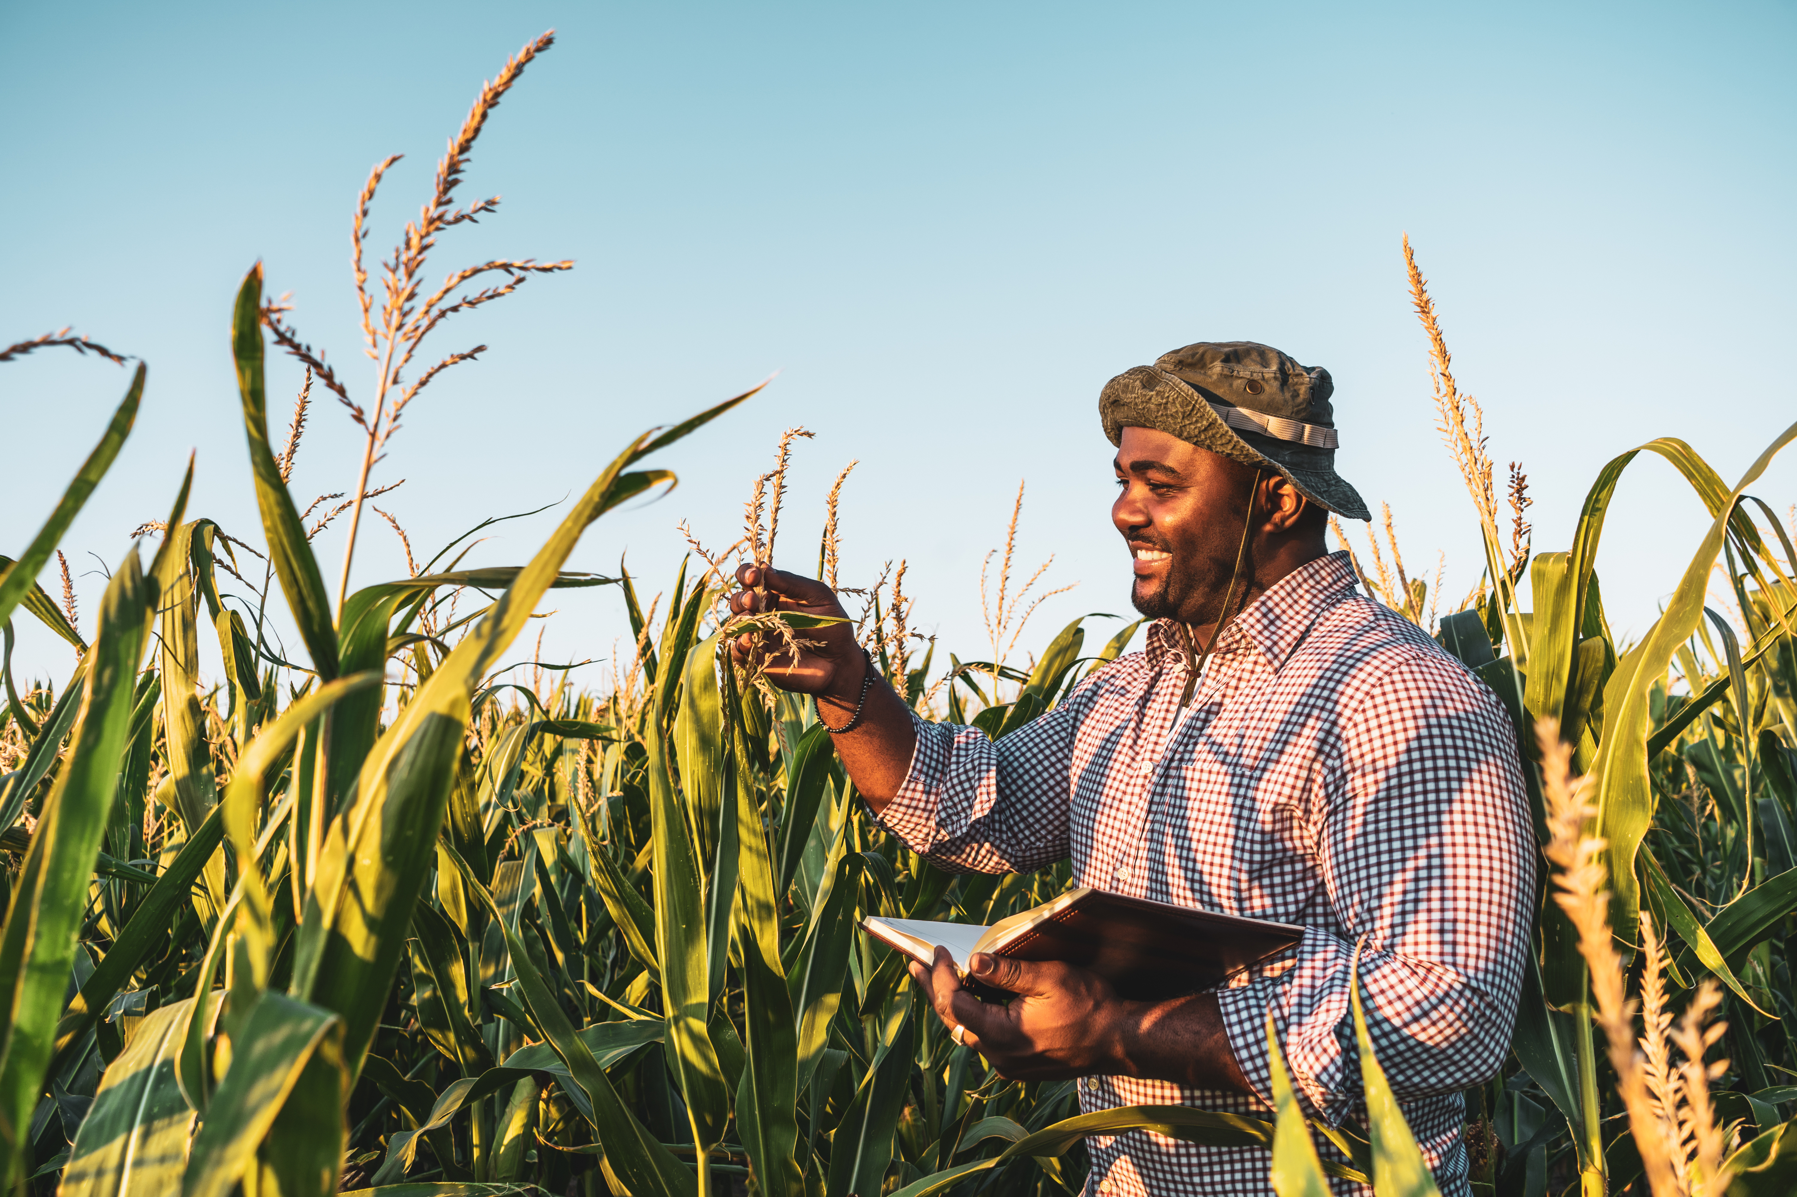

CROP YIELD PREDICTION
Leveraging Machine Learning for Better Agricultural Decisions : Predict, Prevent, Prosper
Presentation By :
DENISH TRADA

Slide 2

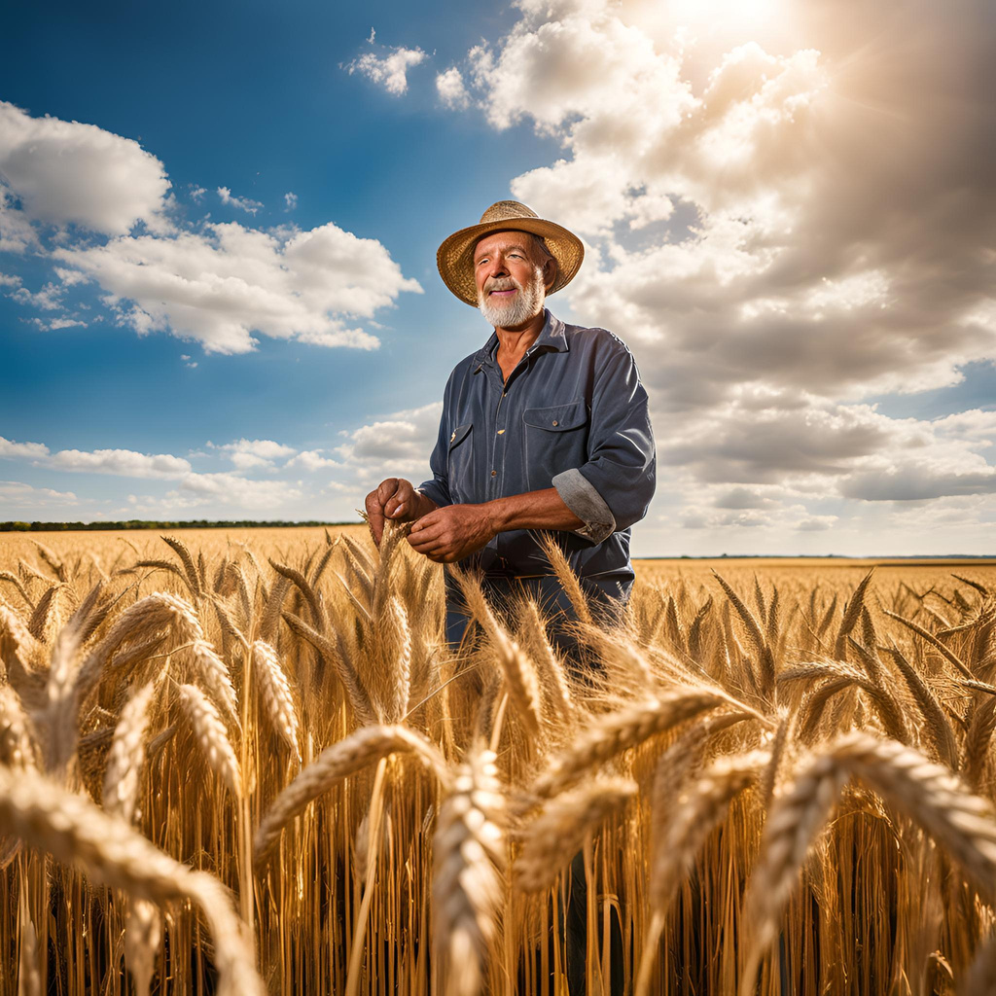
Challenge:
Crop yield variability affects food security and resource planning.
Solution:
Machine learning models predict yield using environmental and agronomic features.
Impact:
Optimize fertilizer and irrigation use
Enable targeted policy and subsidy allocation
Scalable for regional AgriTech use

Slide 3
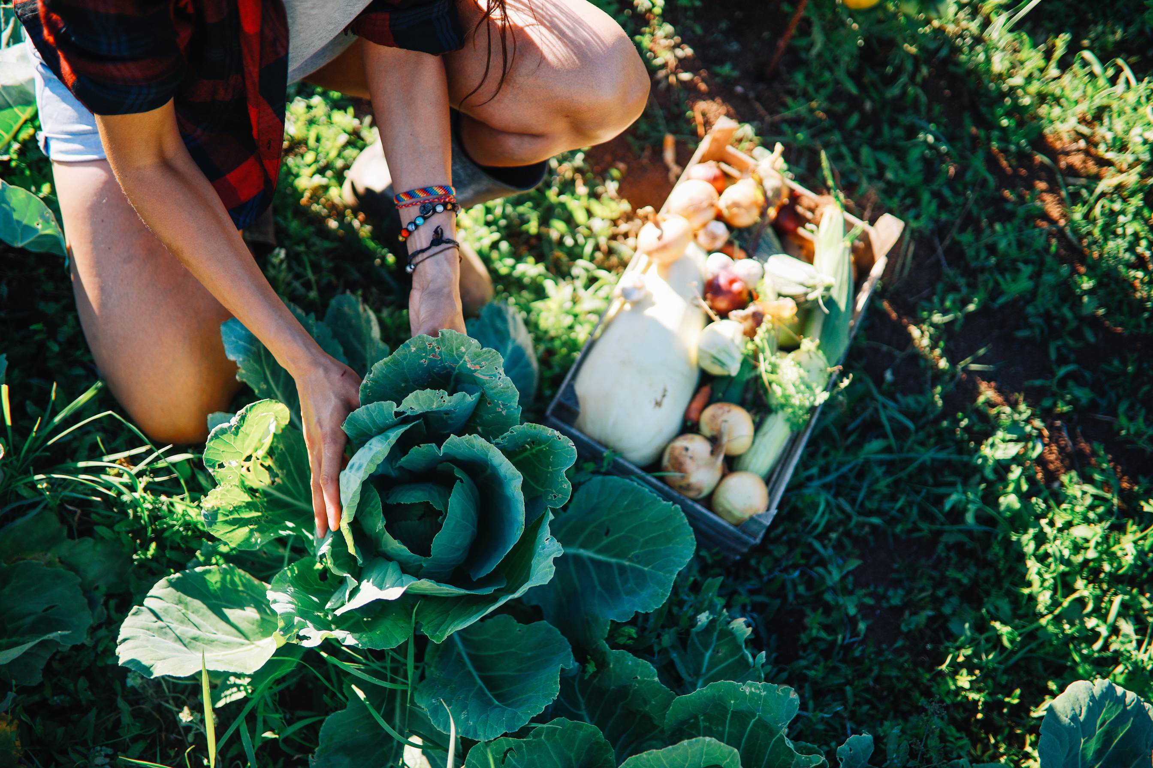

DATASET SOURCE
Kaggle Agriculture Crop Yield dataset
DATA OVERVIEW
PREPROCESSING
Cleaned missing/inconsistent values
One-hot encoding of categorical features
Added Cluster via KMeans for regional grouping
FEATURES USED
Rainfall, Temperature, Fertilizer_Used, Irrigation_Used, Region, Soil_Type, Crop, Weather_Condition, Days_to_Harvest

Slide 4
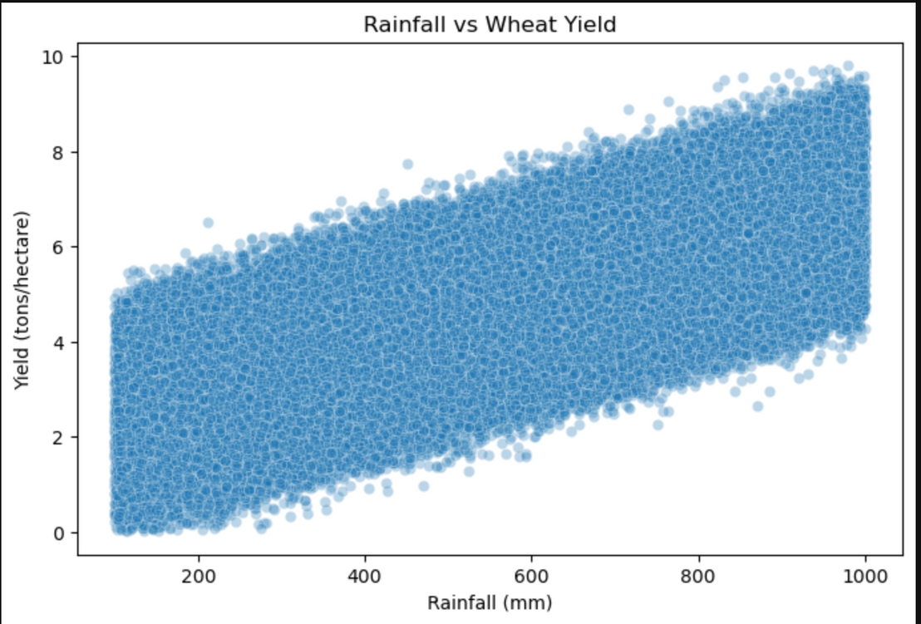
KEY EDA FINDINGS
Rainfall is the strongest predictor of wheat yield.
Fertilizer use consistently increases yields (~1.5 tons/ha).
Other factors (soil, region, temperature) had limited impact in this dataset.
Data science confirmed domain knowledge—focus efforts where it matters!
Top Drivers Identified:
Rainfall (positive correlation)
Fertilizer and Irrigation use
Temperature and Days to Harvest (moderate influence)

Slide 5
MODEL COMPARISON & INTERPRETATION
Interpretation:
Most of the yield variation can be explained by rainfall and fertilizer alone.
Simple, transparent models outperformed complex ones—easy to trust, easy to use.
Models Trained:
Linear
Ridge
Lasso
Random Forest
Best Model:
Ridge Regression (R² = 0.78, RMSE = 0.79 tons/ha)

Slide 6
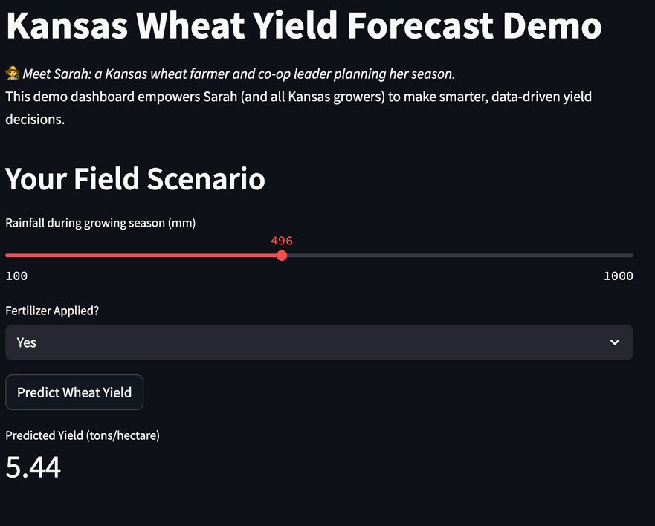
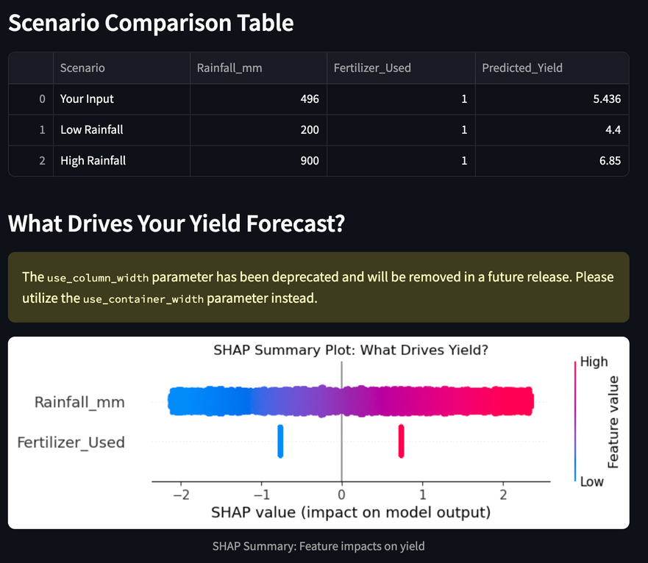
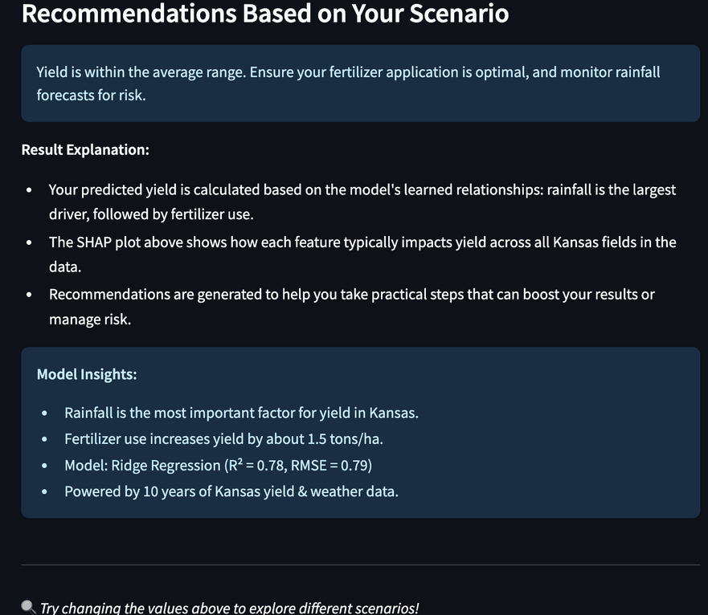
INTRODUCING THE KANSAS WHEAT YIELD DASHBOARD
Users (farmers, advisors) input rainfall and fertilizer plans.
Dashboard predicts yield instantly and explains what drives the result.
Features:
Scenario planning (“what if”)
Transparent model logic (SHAP insights)
Actionable recommendations

Slide 7
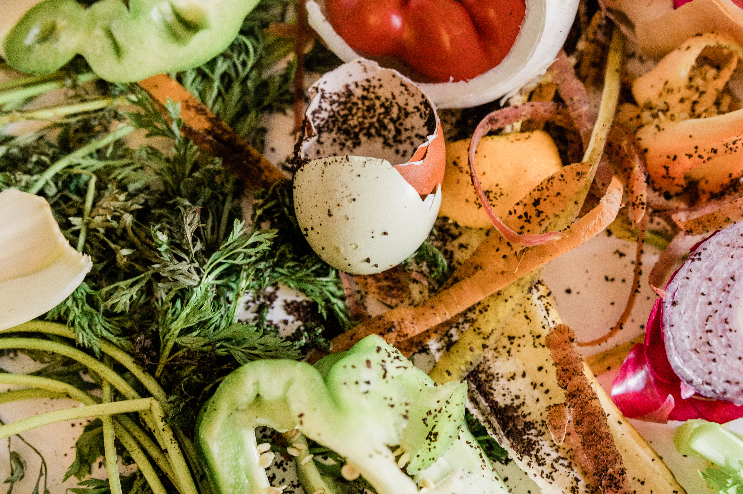

REAL-WORLD VALUE & WHAT’S NEXT
Empowers growers to plan better, reduce risk, and increase profitability.
Stakeholders get clear, explainable forecasts—not just numbers.
Future Opportunities:
Integrate real-time weather data
Expand to other crops or regions
Build mobile and reporting features

Slide 8
THANK YOU
Sustainable agriculture is key to a healthier, more resilient planet.

